Slide 1

Sprocket Central Pvt Ltd
Data analytics approach
Aman Abdulla

Slide 2
Agenda
Introduction
Data Exploration
Model Development
Interpretation

Slide 3
Introduction
Place headline insight or information here. This should be the most important point for this slide.
Outline of Problem
Sprocket Central is a company that specializes in high-quality bikes and cycling accessories.
Their marketing team is looking to boost business sales by analyzing provided datasets.
Using the 3 datasets provided the aim is to analyze and recommend 1000 customers that Sprocket Central should target to drive higher value for the company.
Contents of Data Analysis
'New' and 'Old Customer Age Distributions
Bike related purchases over the last 3 years by gender
Job industry distributions܀ Wealth segmentation by age category
Number of cars owned and not owned by state
RFM analysis and customer classification
This will be done with the three phases of: Data Exploration, Model Development, and Interpretation.

Slide 4
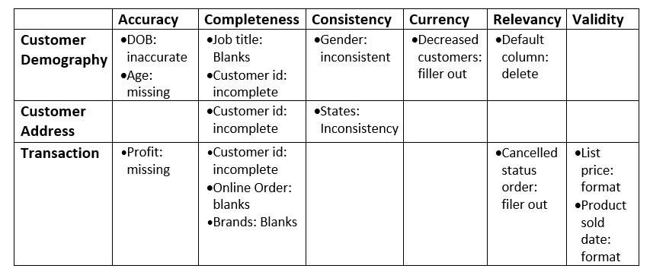
Data Exploration
Data Quality Assessment and Clean up
Key Issues for Data Quality Assessment
Accuracy: Correct Values
Completeness: Data Fields with Values.
Consistency: Values Free from Contradiction
Currency: Values up to Date
Relevancy: Data items with Value Meta-data
Validity: Data Containing Allowable Values
Uniqueness: Records that are Duplicated
An in-depth analysis has been sent via email.
Summary Table

Slide 5
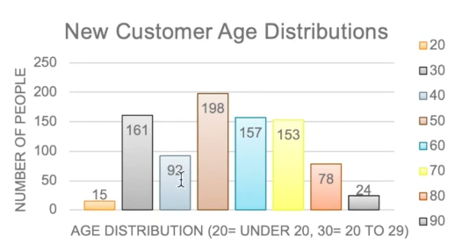
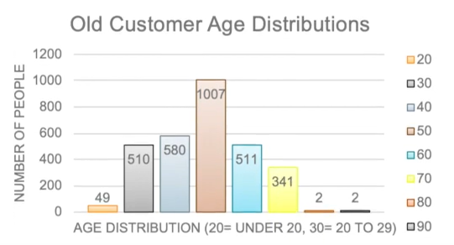
Data Exploration
'New' and 'Old' Customer Age Distributions
Most customers are aged between 40-49 in ‘New’.
In ‘Old’ majority of customers are aged between 40-49 also.
The lowest age groups are under 20 and 80+ for both 'New' and 'Old’ customer lists
The ‘New’ customer list suggests that age groups 20 29 and 40-69 are most populated.
The ‘Old’ customer list suggests 20-69.There is a steep drop of customers in the 30-39 age group in ‘New’

Slide 6
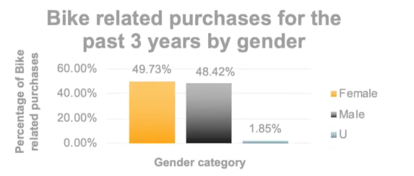
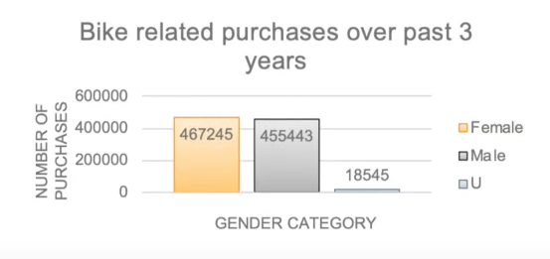
Data Exploration
Bike related purchases over last 3 years by gender
Over the last three years about 50% of bike related purchases were made by females to 48% of purchases made by males. Approximately 2% were made by unknown gender
Numerically, females purchases almost 10 000 more than males
Females make up majority of bike related sales

Slide 7
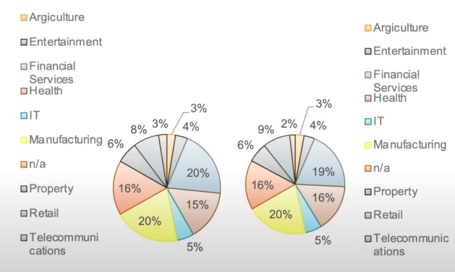
Data Exploration
Job Industry Distribution
20% of 'New Customers are in Manufacturing and Financial Services.
The smallest number of customers are in Agriculture and Telecommunications at 3%
Similar pattern in 'Old' customer list, at 20% and 19% in Manufacturing and Financial Services respectively
‘New’ Customer list ‘Old’ Customer list

Slide 8
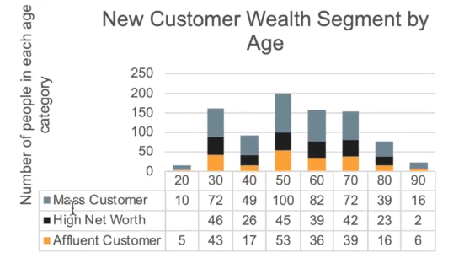
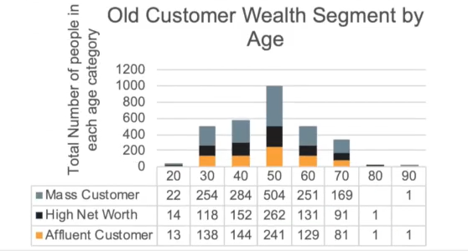
Data Exploration
Wealth Segmentation by age category
In all age categories the largest number of customers are classified as Mass Customer
The next category is the High Net Worth' customers.
The 'Affluent Customer can outperforms the High Net Worth customer in the 40-49 age group.

Slide 9
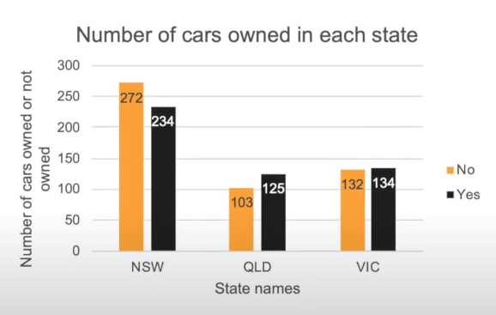
Data Exploration
Number of cars owned and not owned by state
NSW has the largest amount of people that do not own a car. NSW seems to have a higher number of people from which data was collected.
Victoria is also split quite evenly. But both numbers are significantly lower than those of NSW.
QLD has a relatively high number of customers that own a car

Slide 10
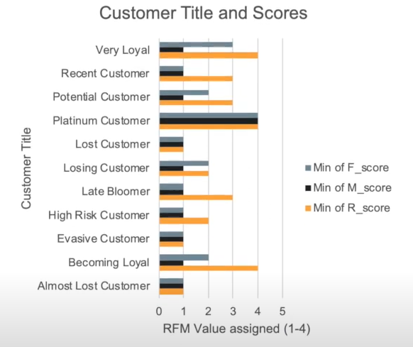
Model Development
RFM Analysis and Customer Classification
RFM analysis is used to determine which customers a business should target to increase its revenue and value.
The RFM (Recency, Frequency, and Monetary) model shows customers that have displayed high levels of engagement with the business in the three categories mentioned.

Slide 11
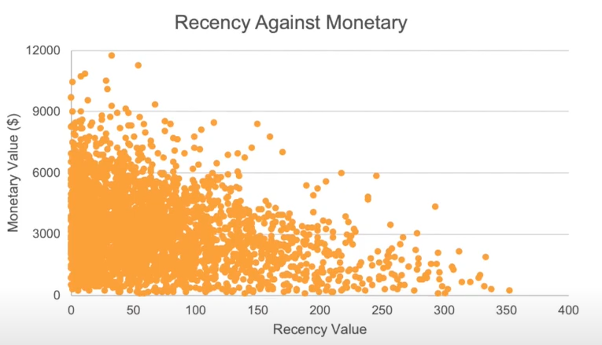
Model Development
Scatter-Plot based off RFM Analysis
The chart shows that customers who purchased more recently have generated more revenue, than customer who visited a while ago.
Customers from recent past (50-100 days) also show to generate a moderate amount of revenue
Those who visited more than 200 days ago generate low revenue.

Slide 12
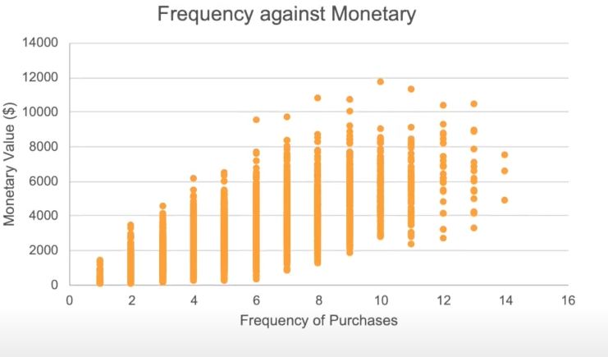
Model Development
Scatter-Plot based off RFM Analysis
Customer classified as "Platinum Customer," "Very Loyal," and "Becoming Loyal" visit frequently, which correlated with increased revenue for the business
Naturally, there is a positive relationship between frequency and monetary gain for the business.

Slide 13
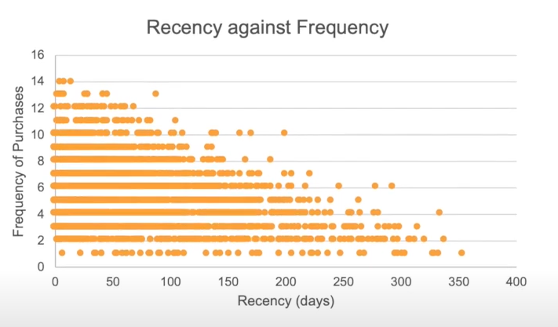
Model Development
Scatter-Plot based off RFM Analysis
Customer classified as "Platinum Customer," "Very Loyal," and "Becoming Loyal" visit frequently, which correlated with increased revenue for the business
Naturally, there is a positive relationship between frequency and monetary gain for the business.

Slide 14
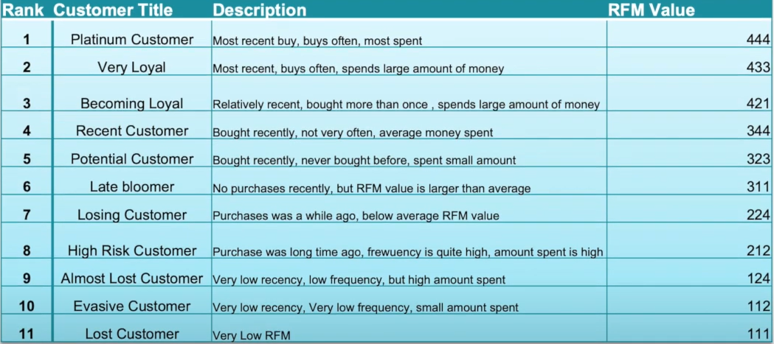
Model Development
Customer Title Distribution list with RFM value assigned

Slide 15
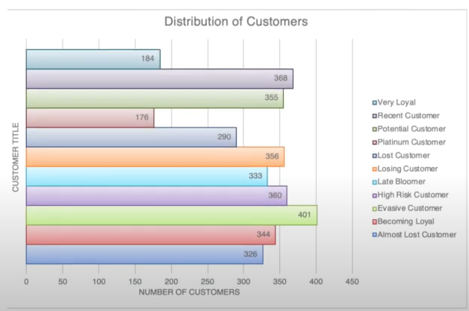
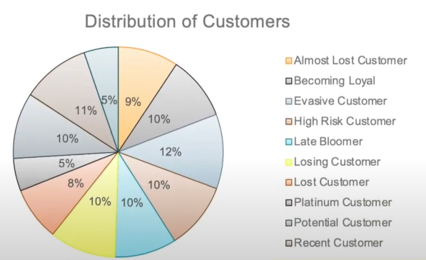
Model Development
Customer Title Distribution list in dataset

Slide 16
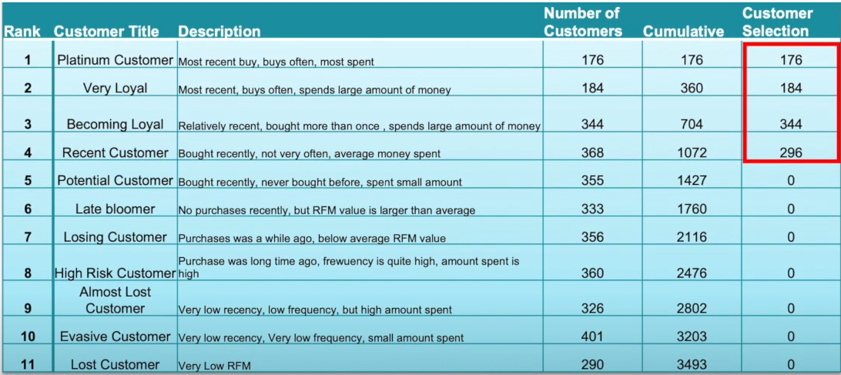
Interpretation
Summary table of top 1000 customer to Target

Slide 17
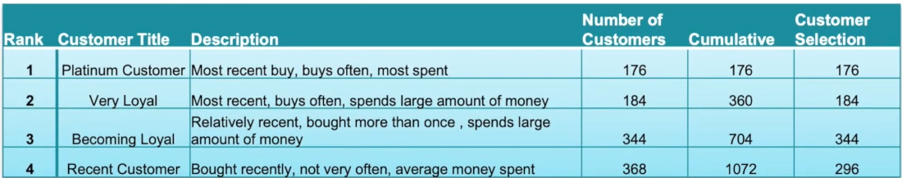
Interpretation
Customer Target and Methodology
Filter through the top 1000 customers by assigning the conditions discussed in the the table above.
The 1000 customers discovered would have bought recently, they have bought very frequently in the past and tend to spend more than other customers.

Slide 18
Thank You.

